Slide 1
3D Object Representations:
Raw data, surfaces, and solids
CS 460: COMPUTER GRAPHICS
Notes:
Subdividing spline:
http://www.youtube.com/watch?v=iwKgyDQNjeE
Snake like (curve example):
http://www.youtube.com/watch?v=8LhHy7ATtCs
Car body:
http://www.youtube.com/watch?v=V708IbtC6I8&NR=1

Slide 2
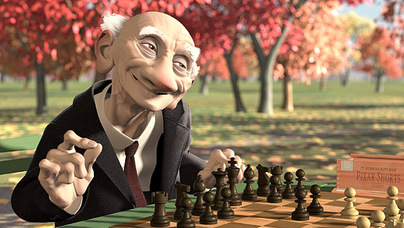
Geri’s Game (1998) : Pixar Animation Studios

Slide 3
Modeling
How do we ...
  Represent 3D objects in a computer?
  Construct such representations quickly and/or automatically with a computer?
  Manipulate 3D objects with a computer?
3D Representations provide the foundations for Computer Graphics, Computer-Aided Geometric Design, Visualization, and Robotics
Different methods for different object representations

Slide 4
3D Object Representations
Raw data
  Point cloud
  Range image
  Polygon soup
Surfaces
  Mesh
  Subdivision
  Parametric
  Implicit
Solids
  Voxels
  BSP tree
  CSG

Slide 5
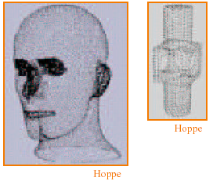
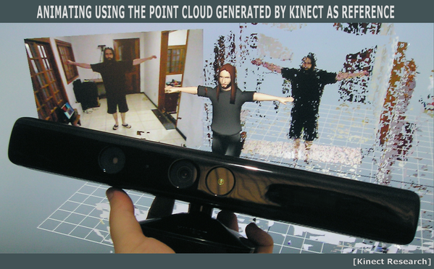
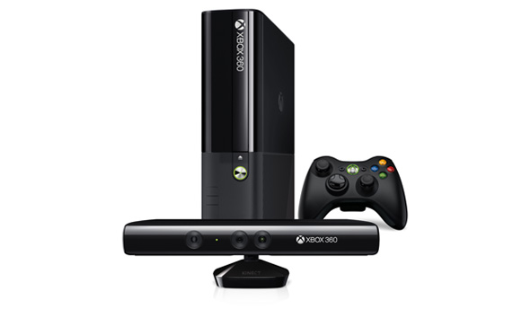
Point Cloud
Unstructured set of 3D point samples

Slide 6
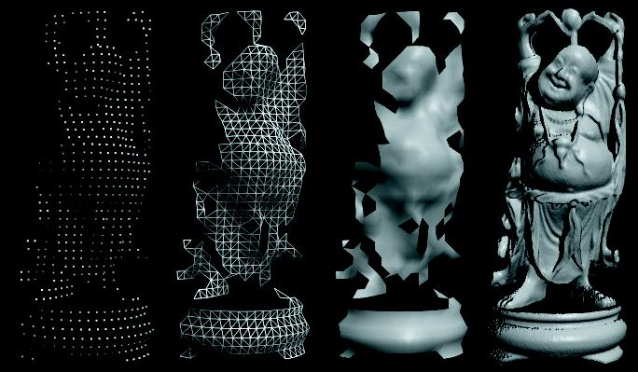
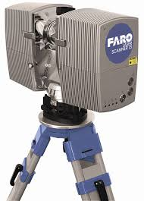
Range Image
Set of 3D points mapping to pixels of depth image
  Acquired from range scanner
Range image
Tessellation
(after creating
Triangles)
Shaded
rendering
High resolution
image

Slide 7
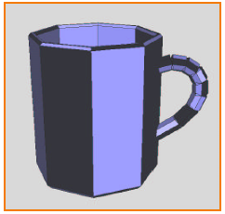
Polygon Soup
Unstructured set of polygons
(How we usually do in OpenGL)

Slide 8
3D Object Representations
Raw data
  Point cloud
  Range image
  Polygon soup
Surfaces
  Mesh
  Subdivision
  Parametric
  Implicit
Solids
  Voxels
  BSP tree
  CSG

Slide 9
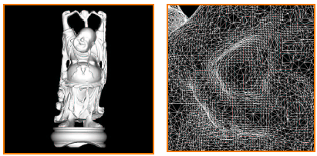
Mesh
Connected set of polygons (usually triangles)
  May not be closed

Slide 10
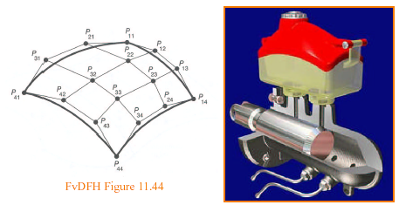
Parametric Surface
Tensor product spline patchs
  Careful constraints to maintain continuity

Slide 11
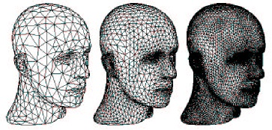
Subdivision Surface
Coarse mesh & subdivision rule
  Define smooth surface as limit of sequence of refinements

Slide 12
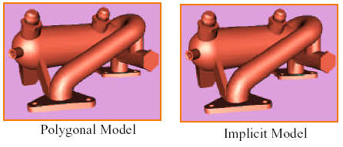
Implicit Surface
Points satisfying: F(x,y,z) = 0

Slide 13
3D Object Representations
Raw data
  Point cloud
  Range image
  Polygon soup
Surfaces
  Mesh
  Subdivision
  Parametric
  Implicit
Solids
  Voxels
  BSP tree
  CSG

Slide 14
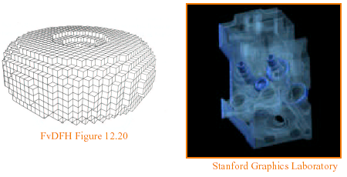
Voxels
Uniform grid of volumetric samples
  Acquired from CAT, MRI, etc.

Slide 15
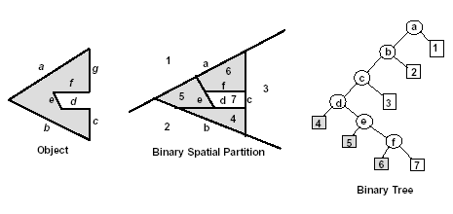
BSP Tree
Binary space partition with solid cells labeled
  Constructed from polygonal representations

Slide 16
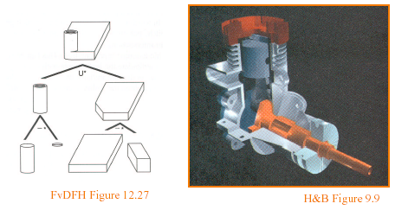
CSG (constructive solid geometry)
Hierarchy of boolean set operations (union, difference, intersect) applied to simple shapes

Slide 17
Parametric Surfaces

Slide 18
Ways of Making Curved Surfaces
Some common ways:
Tensor Product Surface
Trimmed Surface
Surface of Revolution (Extrusion in VRML)
General Sweep Surface
Frenet Frame and Frenet sweep surfaces
There are many others: NURBS, implicit surface, etc.

Slide 19
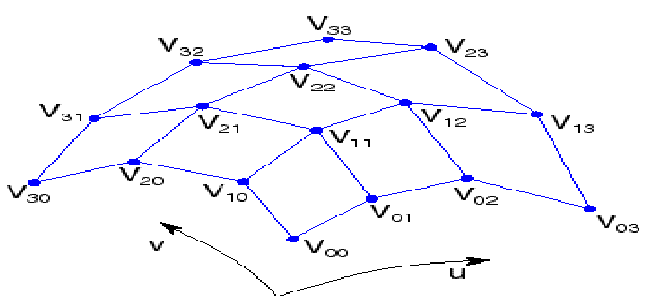
1. Tensor Product Patch
Given a grid of control point V_{ij} (4x4), forming a control net, construct a surface S (u , v ) by:
Treat rows along v direction as control points for curves V₀(u ), …, V_{n}(u ).
Treat V₀(u ), …, V_{n}(u ) as control points for curves parameterized by v.
* supported by OGL (Chapter on Evaluator)

Slide 20
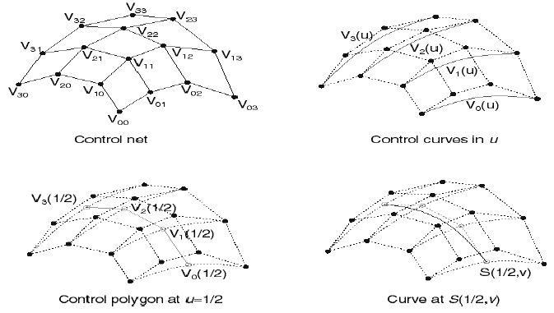
1. Tensor Product Patch
Let’s walk through the steps:
1. Given control net
2. Four control curves along u
3. Control polygons at u=1/2
4. Curve: S(1/2,v)

Slide 21
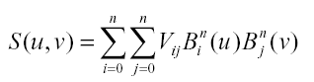
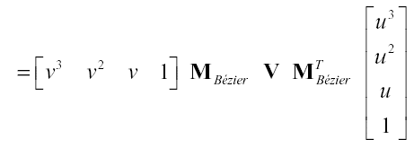
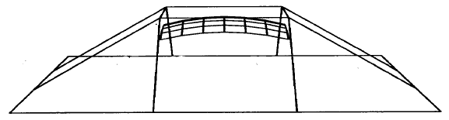
1. Tensor Product Patch
In Matrix Form:
Example: B-spline surface
Note: similar to B-spline curve,
the surface does not pass
through any control points

Slide 22
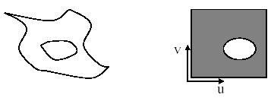
2. Trimmed Surface
Sometimes, we want to have control points over which parts of a surface do not get drawn.
For example:
We can do this by trimming the u-v domain.
  Define a closed curve in the u-v domain (a trim curve)
  Do not draw the surface points inside this curve
u-v domain
(i.e. texture map)

Slide 23
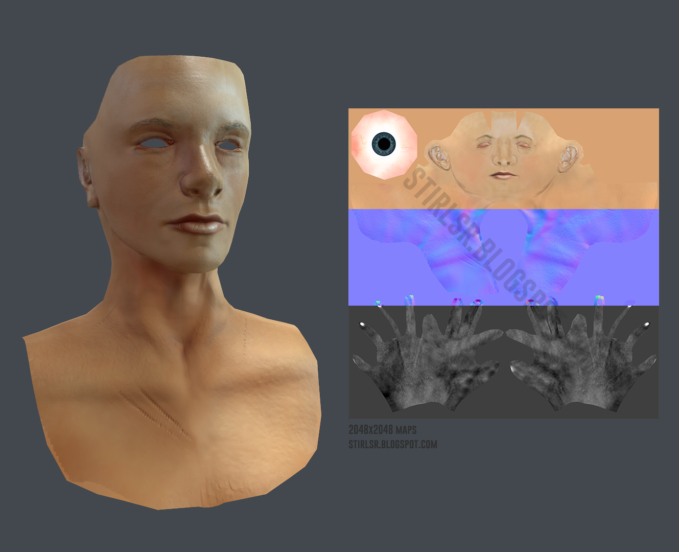
2. Trimmed Surface
trimmed eyes
uv- map
Define holes at the eyes

Slide 24
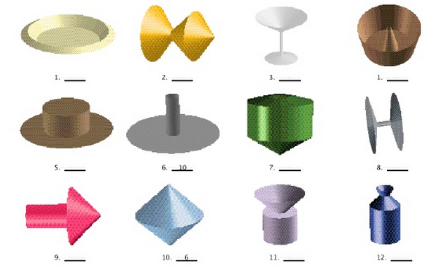
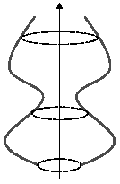
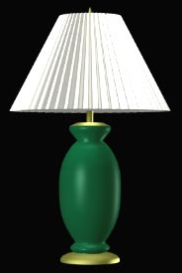
3. Surface of Revolution
Ideal: Rotate a 2D profile curve C(u) around an axis.
What kinds of shapes can you model this way?
  Vase, Bottle, Chess pieces, etc.
C(u)

Slide 25
3. Surface of Revolution
Several variations are possible:
Scale C(u) as it moves.
Morph C(u) into some other curve C’(u) as it moves.
Not directly supported by OGL,
but supported by Web3D/X3D/VRML, called “Extrusion”
(see http://www.web3d.org)

Slide 26
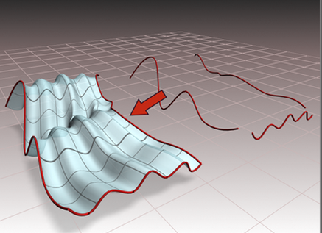
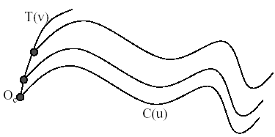
4. General sweep surfaces
The surface of revolution is a special case of a sweep surface.
Idea: Trace out surface S(u,v) by moving a profile curve C(u) along a trajectory curve γ(v).
More specifically:
  Suppose that C(u) lies in a (x_{c},y_{c}) coordinate system with origin O_{c}.
  For every point along γ(v), slide C(u) so that O_{c} coincides with γ(v).
γ(v)
C(u)

Slide 27
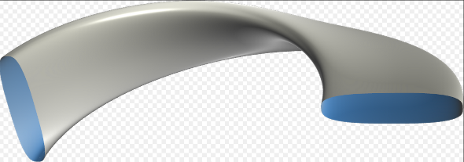

4. General sweep surfaces
Now, how to orient C(u) as it moves along γ(v)?
We can:
  Fixed (or static): Just translate O_{c} along γ(v).
  Moving. Use the Frenet Frame of γ(v).
    Allows smoothly varying orientation
    Permits surfaces of revolution, for example.

Slide 28
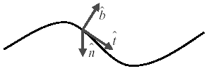
5. Frenet Frame
Motivation: Given a curve γ(t), we want to attach a smoothly varying coordinate system (Normal, Tangent, Binormal):
To get a 3D coordinate system, we need 3 independent direction vectors
As we move along γ(t), the Frenet frame (T,N,B) varies smoothly.
Note binormal is T(t) X N(t)
N
γ(t)
T
B
T is just the tangent at a point on the curve, N is the normal, B is obtained by cross product of N and T

Slide 29
5. Frenet sweep surfaces
Thus, we can orient the profile curve C(u):
  Put C(u) in the normal plane NB.
  Place O_{c} on γ(t).
  Align x-axis for C(u) with N and y-axis for C(u) with B.
N
C(u) in the normal plane NB
γ(t)
T
B
Note: Frenet Frame is useful not only for making sweep surfaces; it can be used
for modeling camera paths or motion paths for 3D objects in animations

Slide 30
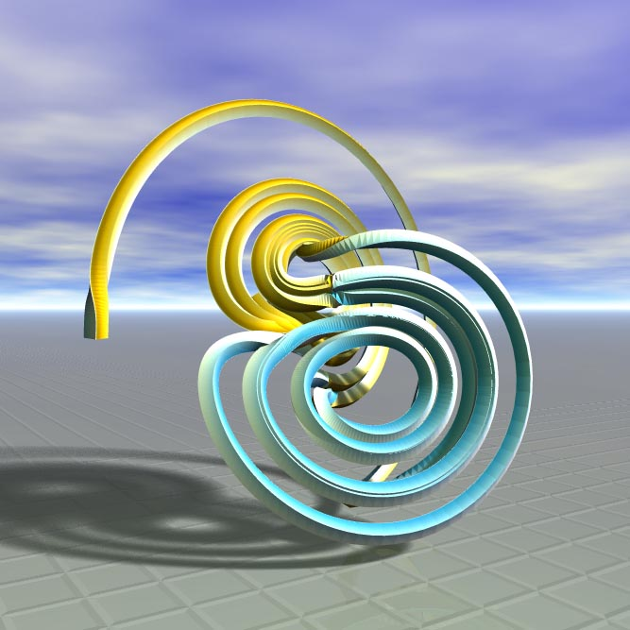
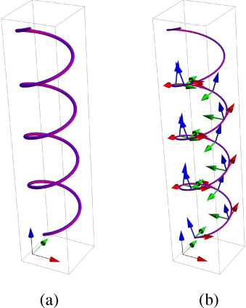

5. Frenet sweep surfaces

